Slide 1
Team Cognitive Training

Slide 2



Improving Quantitative Reasoning by Training Visuo-spatial Working Memory
US students are underperforming
So...

Slide 3

Working Memory
Apply knowledge using general fluid intelligence (gF) to solve problems
gF = short-term memory + working memory (WM)
WM = ability to maintain and manipulate information
WM
Long-term memory

Slide 4
Visuo-Spatial WM
WM = visuo-spatial + auditory + central executive
Visuo-spatial WM ←→ math skills
Train visuo-spatial WM to improve quantitative reasoning

Slide 5

Hypothesis 1:
Cognitive Ability
←→
Quantitative Reasoning

Slide 6
Hypothesis 2:
Cognitive Ability Can Be Trained
Plastic quality of the brain
Cognitive ability can be trained
Training transfer

Slide 7
Hypothesis 3:
Quantitative Reasoning Can Be Improved Through Cognitive Training

Slide 8
Methodology
Recruit Participants
Pre-Test
Training (ABST)
Post-Test
Analysis

Slide 9
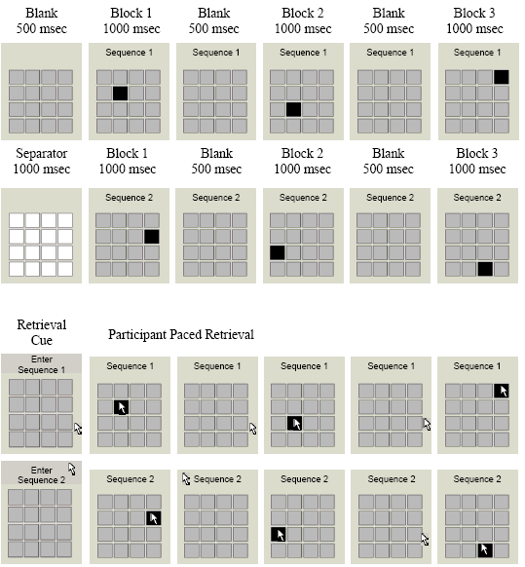
Adaptive Block Span Task

Slide 10
Drawbacks/Limitations
ABST training relies on participants
Testing is time consuming
Levels of education
Participant’s testing ability
Time of day

Slide 11
Pre and Post-tests
Response Inhibition
Working Memory
Perceptual Speed
Reading Comprehension
Math Ability

Slide 12
Timeline
Spring 2009
Thesis Proposal
IRB Approval
Grant Application
Lit Review
Fall 2009
Recruit Participants
Data Collection
Lit Review
Spring 2010
Finish Data Collection
Data Analysis
Write Thesis
Lit Review
Fall 2010
Write Thesis
Lit Review
Spring 2011
Edit Thesis
Lit Review

Slide 13
Budget
Participants: 50 – 100
$20 per participants
  $1000 min.
  $2000 max.
$450 for rewards
$500 for flash drives

