Slide 1

BIOCOUNTER
Bioweapon Inhibition Operating Containment Unit for the Negation of Terrorist Entities and Radicals
Kyle Jamolin
Jon Saltzman
Darrell Schaefer
Sebastian Serrano
Aaron Shim
Josh Sloane
Mentor: Dr. Jeffrey Herrmann
Librarian: Jim Miller

Slide 2

Overview
Research Problem
Purpose and Hypothesis
Literature Review
Methodology
Conclusion
Timeline/Budget

Slide 3
Research Problem
Problem: ambiguity and disorganization after aerosolized anthrax release
Question: What are the problems after an attack?:
- Surveillance
- Investigation
- Determining response
- Executing response

Slide 4
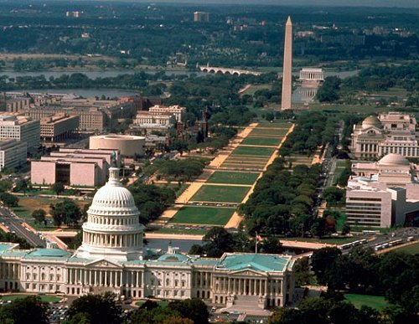
Purpose
Purpose of our research: To determine ways to improve the investigation and decision making of the response to an aerosolized anthrax attack in the DC metropolitan area
Hypothesis: We will figure out improvements to procedures and communication between organizations that, if implemented, would decrease response time and casualties in event of anthrax exposure.
Notes:
Add the importance of the research to the purpose

Slide 5
Literature Review
Surveillance
- BioWatch: technological detection
- BioSense: syndromic surveillance, hospital reports, pharmaceutical purchases
Response
- Cities Readiness Initiative: prophylaxis campaign
- National Response Plan
- Kansas Department of Health study

Slide 6
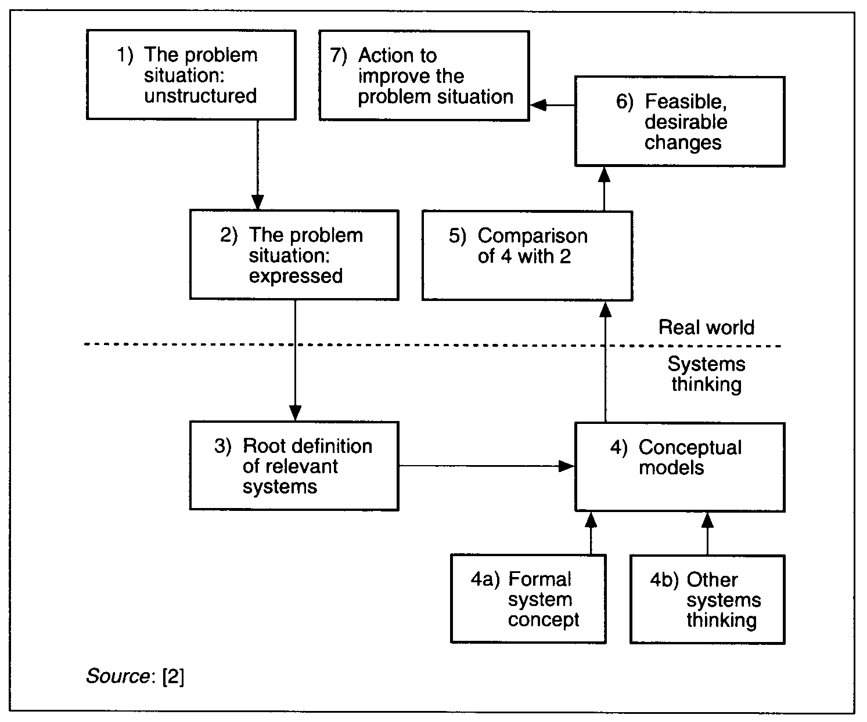
Soft Systems Methodology
Notes:
Understand system as is
Make ideal model of system
Identify changes
Explain main purpose of ssm
Show how this relates to ssm

Slide 7
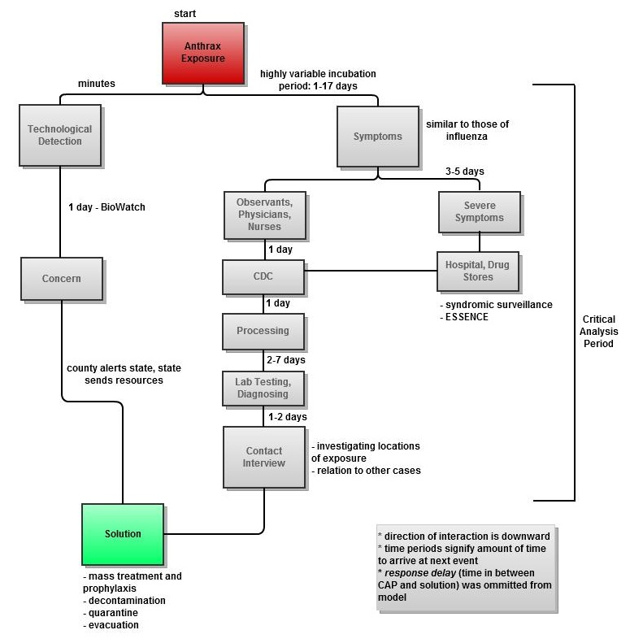
Methodology
IRB Interviews, documents, publications
Models of Interactions
Simulations and Recommendations

Slide 8

Conclusion
Importance of study
- to reduce response time and mitigate casualties
- develop framework of the interactions for future studies
Project Limitations?
- networking connections
- classified documents, etc
- SSM timeframe
Notes:
Don’t speak in absolutes
Connections: dr. herrmann, academics, health officials, government contacts, family

Slide 9
Timeline
Spring 2011:
Describe the problem and form rich pictures
Present final thesis proposal to committee after having it reviewed by librarian
Finalize questions to ask and conclude what information is required from experts
Determination and application of IRB Human Subject Research
Design team website
Determine additional journal subscriptions we needed, conferences to attend, and possible need for additional funding
Apply for grants
Fall 2011:
Rich pictures
Root definition
Form models of interaction and use them in interviews
Outline our final thesis
Attend appropriate conferences
Begin simulation studies
Conduct interviews
Spring 2012:
Models of interaction and comparison with rich pictures
Write first three chapters of thesis (Introduction, Literature Review, and Methodology)
Finalize interviews
Feasible and desirable changes- continue and finalize simulations
Fall 2012:
Finalize feasible and desirable changes
Continue to work on thesis
Finalize list of experts for thesis conference and submit list to Gemstone
Spring 2013:
Action to improve problem situation
Continue to work on thesis
Attend thesis conference
Pursue journal publication
Notes:
Apply ssm to this

Slide 10
Budget
Additional Publication Subscriptions $150
Conference Costs (4 total, 2 members attending each)
- transportation $2,050
- hotel/accommodations $2,050
- attendance $3,300
- books/publications $400
Transportation money to governmental and emergency facilities $200
Total cost: $8,150
*currently seeking grants through the Robert Woods Johnson Foundation and the ACCIAC Fellows Program

Slide 11
Questions?

