Slide 1

BIOCOUNTER
Bioweapon Inhibition Operating Containment Unit for the Negation of Terrorist Entities and Radicals
Kyle Jamolin
Jon Saltzman
Darrell Schaefer
Sebastian Serrano
Aaron Shim
Josh Sloane
Speakers: Darrell Schaefer, Sebastian Serrano,
and Josh Sloane
Mentor: Dr. Jeffrey Herrmann
Librarian: Jim Miller
Notes:
DARRELL

Slide 2

Overview
Research Problem
Purpose
Literature Review
Methodology
Interviews
Rich Pictures
Simulations
Conclusion
Timeline/Budget
Advice
Notes:
DARRELL

Slide 3
Research Problem
Problem: ambiguity and disorganization among local, state, and federal entities after aerosolized anthrax release
Question: What are the problems after an attack?:
- Surveillance
- Investigation
- Determining response
- Executing response
Notes:
DARRELL

Slide 4
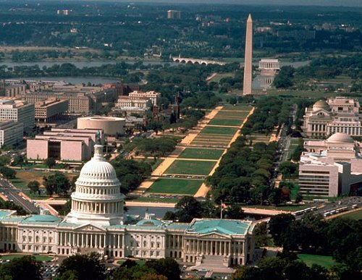
Purpose
Purpose of our research: To determine ways to improve the investigation and decision making of the response to an outdoor aerosolized anthrax attack in the DC metropolitan area
Hypothesis: We will determine improvements to procedures and communication between organizations that, if implemented, would decrease response time and casualties in the event of an anthrax release.
Notes:
DARRELL
Add the importance of the research to the purpose

Slide 5
Literature Review
Surveillance
- Technological: BioWatch
- Syndromic: BioSense, hospital reports, pharmaceutical purchases
Response
- Cities Readiness Initiative (CRI)
- Incident Command System (ICS)
- National Incident Management System (NIMS)
- National Response Framework (NRF)
- District Response Plan (DRP)
Technology
- Plume modeling (HYSPLIT)
Notes:
SEBASTIAN

Slide 6
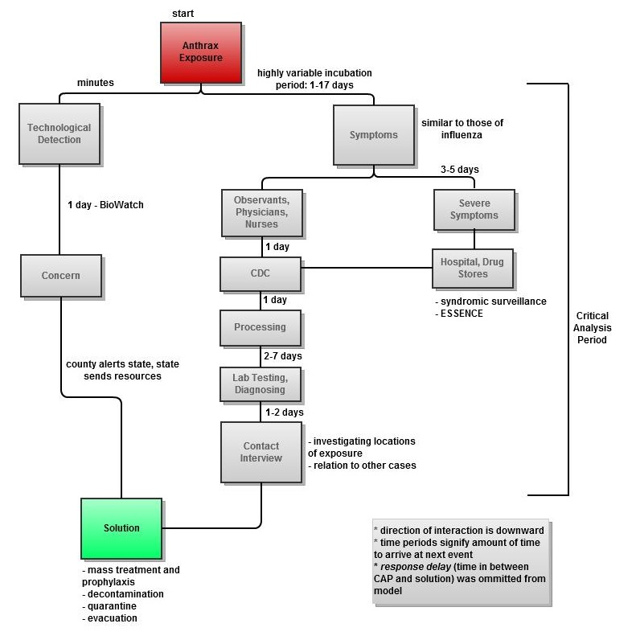
Methodology
Interviews, documents,
publications
Models of Interactions
Plume models and
simulations
Recommendations
Notes:
SEBASTIAN
Understand system as is
Make ideal model of system
Identify changes
Explain main purpose of ssm
Show how this relates to ssm

Slide 7
Sample Interview Questions
Can you guide us through what you and your agency would do following the discovery of a possible aerosolized anthrax attack, paying special attention to time elapsed?
Who has authority over you, and whom do you have authority over?
What issues have you witnessed in past responses or exercises with other local, state, or federal actors with regards to communication, chain of command, or jurisdiction?
Notes:
SEBASTIAN

Slide 8

Federal Contacts
Martin Kalis
  Public Health Advisor, Centers for Disease Control and Prevention (CDC)
Captain Robert Tosatto
  Director, Office of the Civilian Volunteer Medical Reserve Corps (MRC)
Marilyn Quinn
  Federal Bureau of Investigation (FBI)
Edward You
  Federal Bureau of Investigation (FBI)
Notes:
SEBASTIAN

Slide 9
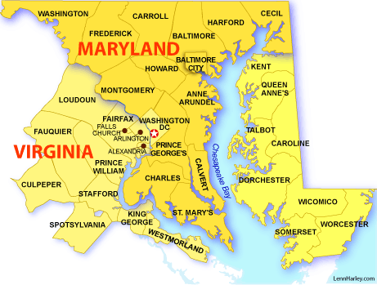
State Contacts
Michael Mannozzi
  Emergency Operations Manager, Maryland Department of Health and Mental Hygiene (DHMH)
Dan Morhaim
  Maryland House of Delegates
Rebecca Chester
  Northern Virginia Region MRC Coordinator
Jeffrey Walker
  Northern Region Emergency Planner, Virginia Department of Health (VDH)
Notes:
SEBASTIAN

Slide 10
Local Officials
Rachel Abbey
  Program Manager, Montgomery County Department of Health and Human Services
Beverly Pritchett
  Health Emergency Preparedness and Response Administration (DC DOH)
Barbara Rosvold
  Frederick County Health Department
Kathy Deffer
  Alexandria Health Department; Medical Reserve Corps
Donald Hall
  Washington, DC NIMS Program Manager (DC HSEMA)
Millicent West
  Homeland Security and Emergency Management Agency (DC HSEMA)
Mike Sellitto
  Washington Regional Threat and Analysis (DC Fire Department)
Notes:
SEBASTIAN

Slide 11
Academic Contacts
Dr. Tim Canty
Dr. Jeff Stehr
Dr. David Mosser
Dr. Nathaniel Hupert
GIS Librarian Lara Otis
Notes:
SEBASTIAN

Slide 12
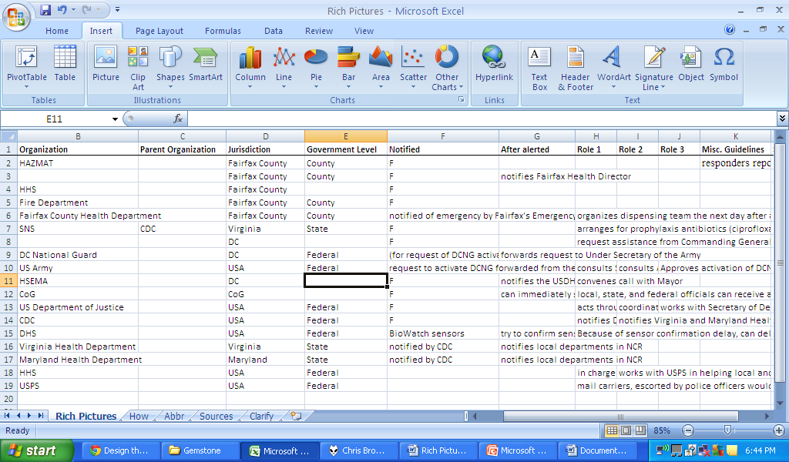
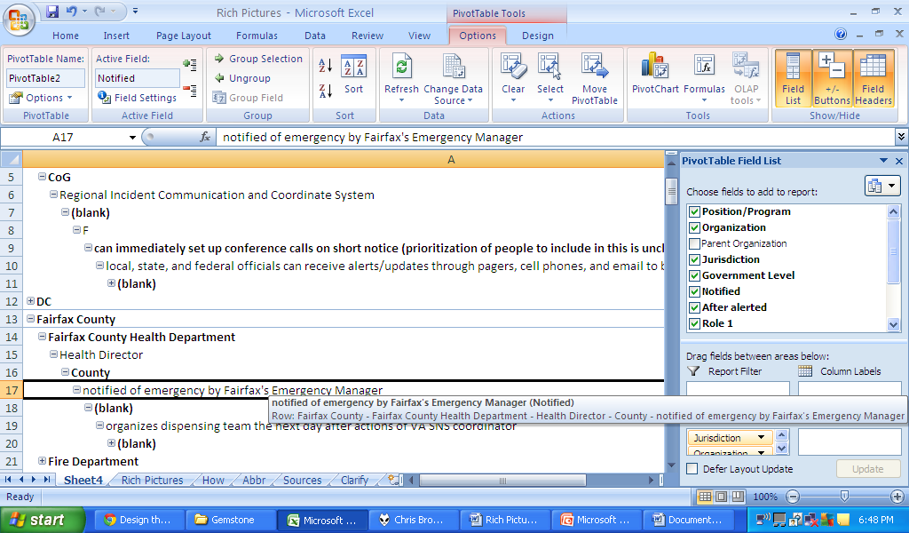
Rich Pictures and Pivot Table
Notes:
SEBASTIAN
1. Compiled document including interactions among all agencies, each agency’s planned response, and other qualitative and quantitative data.
2. Interaction Spreadsheet of Columns: Position/Program, Organization, Parent Organization, Jurisdiction, Government Level, Notified After Alerted, and three columns of Roles, with Sources
3. Pivot Table of Interactions
4. Models of Interaction (final rich pictures product) – diagrammed web of interactions, communication, and roles of response with timeframes

Slide 13
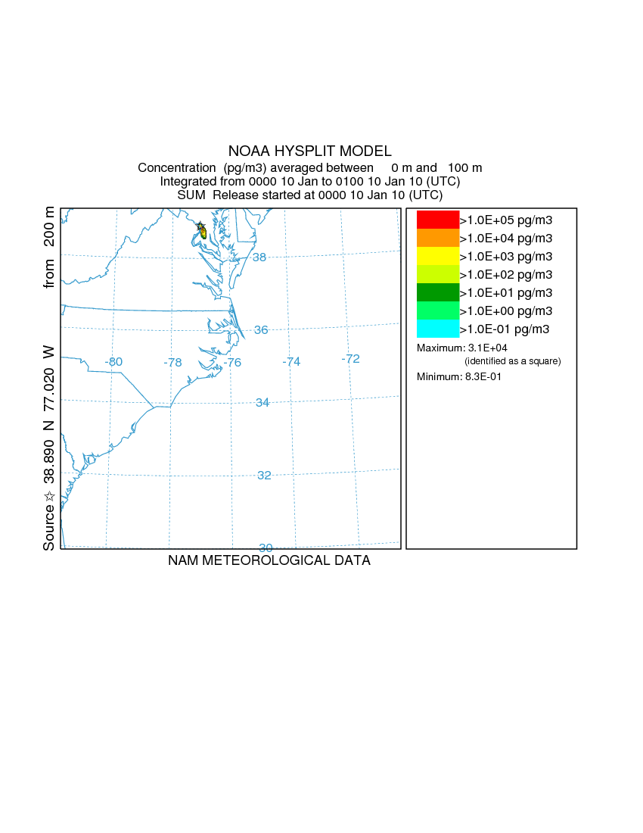
Release Date: January 10, 2010
Simulation length: 24 hours
Release location: National Mall
Release height: 200 meters
1 kg release
Meteorological data from NAM12
Notes:
JOSH
I attended a 3 day workshop on how to use the HYSPLIT dispersion model over the summer. I also began working on the simulation this summer with the help of Drs. Tim Canty and Jeff Stehr
Info on Example anthrax release for Junior Colloquium
Date: December 2nd , 2010
Total Time: 24 hours
Meteorology file sources: NAM12
No wet deposition (yes dry deposition)
Release position: the National Mall. Lat: 38.89. Lon: -77.02. Height: 200m (basically tallest building in DC)
Particle props 1: Particle props 1: "1.5 1.42 1.0"
1 kg release
Output is in picograms
Note: you can see that after about 5 hours, none of the concentration is yellow or more red, which means that the anthrax is already very dispersed (every time it changes color, it decreases an order of magnitude) and potentially won’t be a large enough concentration to be lethal

Slide 14
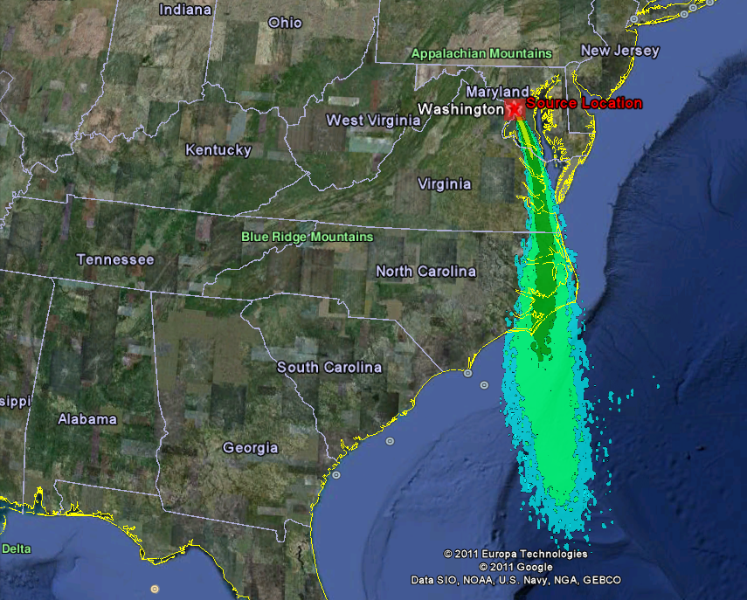

Notes:
JOSH
Average concentration over the 24 hour simulation
On google earth, so easier to see
Purpose of our simulations:
Once we have our rich pictures done, we will begin working on our models of interaction.
This will show the timeline of a response to an anthrax attack, with all of the interactions between different actors
We are interested in how it would look to an epidemiologist who wouldn’t necessarily know that an anthrax attack occurred, and would only have information about when people become symptomatic
To do this, we will use the hysplit dispersion simulation, and overlay a population density map to figure out when people will start getting sick
The chance that someone who inhaled anthrax will get sick after a certain amount of time is given by a formula which calculates the chance that a single anthrax spore will germinate and the total number of spores in the body.
Combining this probability with a population density map, we can determine when and where people will get sick.
We hypothesize that it will look something like this:
CLICK: After about 24 hours, several cases near the initial release where the concentration is highest
CLICK: Then, cases will appear sporadically
We will run several simulations like this, but varying parameters
With these simulation, we will look at our models of interaction and see how we would expect a response to occur
We could also use this to predict any problems with the response. I.e. if one person happens to get sick in one of the low concentration areas, other people in the same area are still not likely to get sick. However, this person’s illness might have a major impact in the response, and the responders might devote the response there instead of where it is more needed.

Slide 15

Conclusion
Importance of study
- Reduce response time and mitigate casualties
- Develop framework of the interactions for future studies
Challenges
- Classified information
- Updated population
density data
Notes:
JOSH
Don’t speak in absolutes
Connections: dr. herrmann, academics, health officials, government contacts, family

Slide 16
Timeline
Spring 2011:
Describe the problem and form final thesis proposal to committee after having it reviewed by librarian
Finalize thesis around comments from proposal committee, questions to ask and what information to gather from experts
Determination and application of IRB Human Subject Research
Design team website
Determine additional journal subscriptions we needed, conferences to attend, and possible need for additional funding
Apply for grants
Fall 2011:
Rich pictures
Form models of interaction and use them in interviews
Outline our final thesis
Continue simulations
Conduct interviews
Update website
Spring 2012:
Models of interaction and comparison with rich pictures
Write first three chapters of thesis (Introduction, Literature Review, and Methodology)
Finalize interviews
Feasible and desirable changes- continue and finalize simulations
Update website
Fall 2012:
Finalize feasible and desirable changes
Continue to work on thesis
Finalize list of experts for thesis conference and submit list to Gemstone
Update website
Spring 2013:
Action to improve problem situation
Complete thesis
Attend thesis conference
Present recommendations to relevant agencies
Update website
Notes:
JOSH
Apply ssm to this

Slide 17
Budget
LandScan - $1500
  Designed to display population density
  Required to view 2010 information
ArcGIS - $1500
  Program related to LandScan
Notes:
JOSH
Currently in process of using a trial offer of LandScan. If good results, UMD Library will purchase and have it ready by summer. In the mean time, we will use 2000 Census data. May not require ArcGIS.

Slide 18
Team Dynamics and Advice
Rich pictures team
Simulations team
Email/ Endnote/ Dropbox/ Google Docs
Gemstone comes first
Mentor = Guidance
Notes:
JOSH

Slide 19
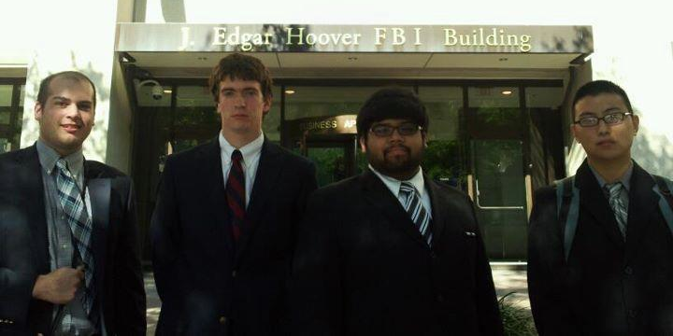
Questions?
Notes:
JOSH

