Slide 1
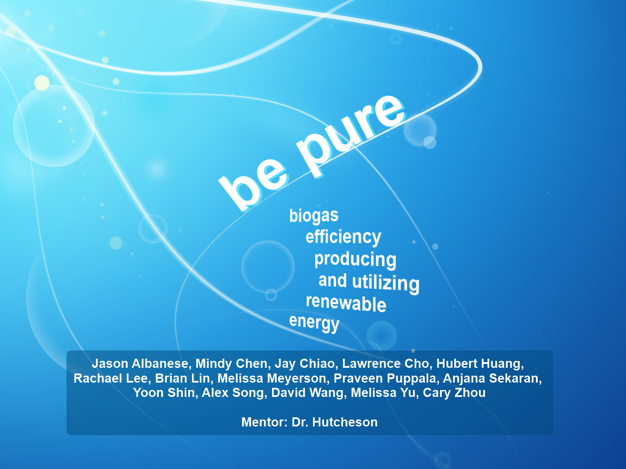

Slide 2
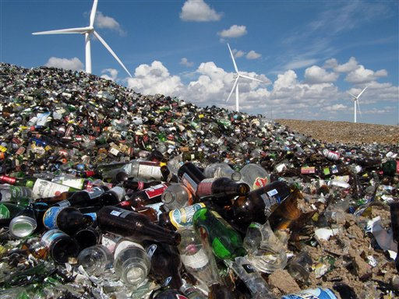
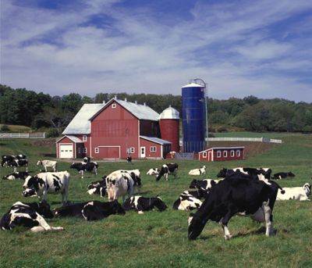
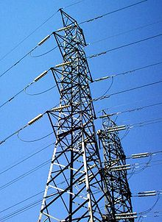
Problem Overview & Significance
Ongoing energy crisis
Depletion of fossil fuels
Search for an alternative energy source
Biogas is underutilized
Affordable and can be widely used

Slide 3
Biogas Composition

Slide 4
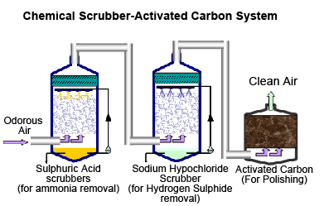
Why a Biological Method?
Chemical Method
  Environmentally damaging
  Expensive
  Nonrenewable
Biological Method
  Carbon fixation
  Algal oil

Slide 5
Research Questions
What are the differences in concentrations of methane and CO2 before and after purification of raw biogas?
What is the cost of constructing and maintaining our biological purification system?
How does the cost compare to that of chemical methods?

Slide 6
Hypothesis
We hypothesize that a purification utilizing microbes will be more cost-efficient and sustainable than current purification methods while yielding higher methane concentrations

Slide 7
Raw biogas
Purified Biogas
H₂S Scrub
CO₂
Scrub
Algae
CO_{2,} H₂O
Generator
H₂O
Solid wastes recycled
Algal Oil

Slide 8
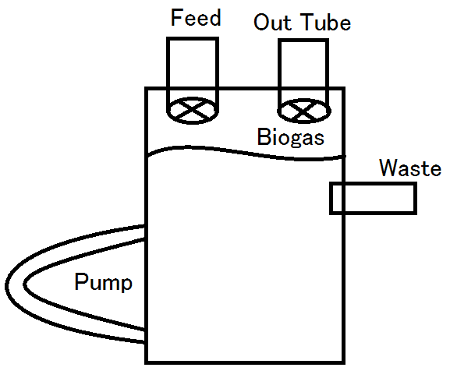
Anaerobic Digester
5 gallon anaerobic digestor
Manure-based innoculum
Different feeds for different composition
Pumped and stirred
Biogas removed from valve on top

Slide 9
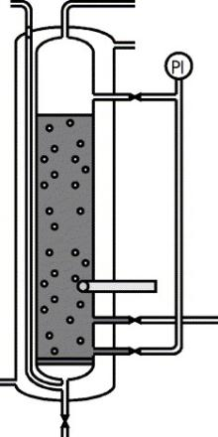

Chemical Removal of H2S
ADD IMAGE HERE
Column of copper sulfate
Countercurrent exchange
  Gas fed into bottom
  Bubbled through

Slide 10
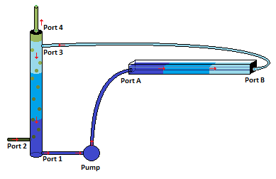
CO2 Scrubbing
Gas fed through sparger at bottom of column
  Raschig rings and water
CO2 rich water exits at bottom, algae purified water enters on top
    Countercurrent exchange

Slide 11
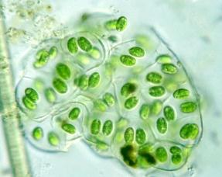
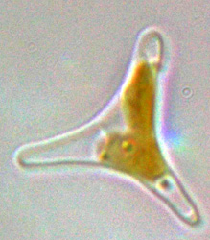
Algal System
Testing two species
  Chlorococcum littorale
  Phaeodactylum tricornutum
  High levels of CO2
  Algal oil byproduct
  Living requirements

Slide 12
Challenges and Limitations
Algae group environment
Biogas composition
Experimenters
Generalizability

Slide 13
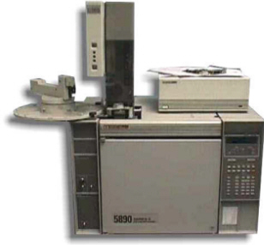
Analysis
Cost
Gas composition
  Gas chromatography
Purification efficiency

Slide 14
Research Implications
Industrial scale
Self-sustaining system
Cost-efficiency
Environmentally friendly
Natural gas grade product

Slide 15
Timeline
Sophomore Year
  Apply for grants
  Finalize models, gather materials, construct models
  Pilot studies
Junior Year
  Make modifications based on pilot studies
  Complete testing
  Analyze data and draw conclusions
Senior Year
  Complete thesis
  Present at thesis conference

Slide 16
Special Thanks to…
Our mentor, Dr. Hutcheson
The entire Gemstone Staff
Dr. Lansing, Dr. Sriram, Dr. Calabrese, and Dr. Felton
Our librarians, Ms. Tchangalova and Ms. Stilwell

Slide 17
Questions?

