Slide 1
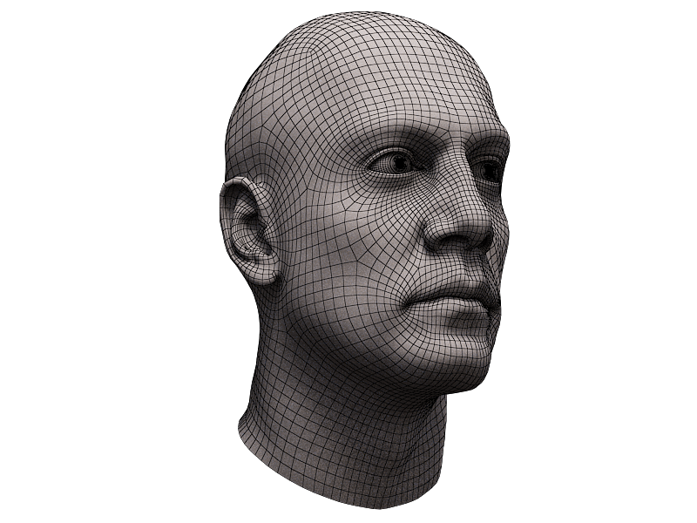
TEAM BLAST
Blast Localization and Sensing Technology
Ani, Beaudoin, Green, Henricks, Jones, Kennedy, Mawhinney, Peluso, Reilly, Schwartz, Shapiro, Yanushevsky
Image Courtesy of: Stanislav Klabik

Slide 2
MOTIVATION
10-20% of soldiers in Iraq and Afghanistan have sustained TBI, primarily from IED detonations. (Ortega 2011)
New Kevlar armor and helmets cannot protect against closed head injuries produced by blasts. (Okie 2005)
59% of people who endure a blast suffer from TBI. (Okie 2005)
Notes:
By shielding soldiers from bullets and shrapnel, protective gear has improved survival rates during combat, but does not protect against closed-head injuries.
[1] S. Okie. “Traumatic brain injury in the war zone.” The New England Journal of Medicine. vol. 352, pp. 2043-2047, May 2005.

Slide 3
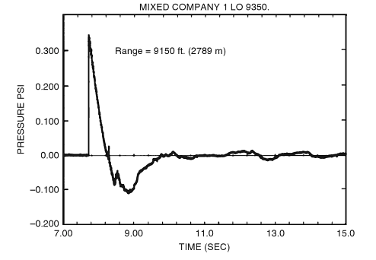
Mechanism of Blast-Related TBI
Blast waves are high-energy pressure waves. (Scheve)
Blast waves can transfer energy to the head, causing strain and acceleration of brain tissue. (Scheve)
Image: Needham 2010
Notes:
[2] How Blast-resistant Clothing Works, howstuffworks.com… someone else do this!
[3] Mikulas Chavko, Tomas Watanabe, et. al. “Relationship between orientation to a blast and pressure wave propagation inside the rat brain.” Journal of Neuroscience Methods, vol. 195, pp. 61-6, Jan. 2011.
Strain is the measurement of brain tissue deformation
Acceleration is a measurement of how fast brain tissue deformation occurs
This is known as a primary blast injury. These have been shown to alter the brain’s biochemistry and morphology similar to the effects of other injuries such as penetration and fragmentation³.

Slide 4
LITERATURE REVIEW
Existing Models
Models have been produced that correlate blast magnitude and direction with internal brain stresses.
(Chafi 2010) (Balachandran 2010)
Brain tissue is viscoelastic, which behaves differently than typical elastic materials. (Balachandran 2010)
Existing Hardware
Current helmets used by the U.S. army implement pressure sensors to record impact direction, magnitude, duration, and local pressure. (BAE Systems)
Blast location can be determined via localization algorithms. (Ash 2010)
Notes:
Notecard for viscoelastic materials
[4] M. S. Chafi, G. Karami and M. Ziejewski. “Biomechanical Assessment of Brain Dynamic Responses Due to Blast Pressure Waves.” Annals of biomedical engineering, vol. 38, pp. 490-504, Feb. 2010.
[5] B. Balachandran, M.F. Valdez, “Investigations into Wave Propagation in Soft Tissue,” 26th Southern Biomedical Engineering Conference SBEC2010, pp. 13-17, May 2010.
[6] http://www.gizmag.com/heads-generation-ii-helmet-sensor/15898/
http://events.us.baesystems.com/AUSA11/prodserv/pdf/BAE-SystemsHEADS-Generation-II-Factsheet.pdf
[7] Ash, J.N. et al. “Performance of shockwave-based shooter localization under model misspecification,” in IEEE International Conference on Acoustics Speech and Signal Processing (ICASSP), 2010, pp. 2694-2697.
[8] M. Alley, B Schimizze, and S. Son, "Experimental modeling of explosive blast-related traumatic brain injuries," NeuroImage, vol. 54, pp. 45-54, May 2010.

Slide 5
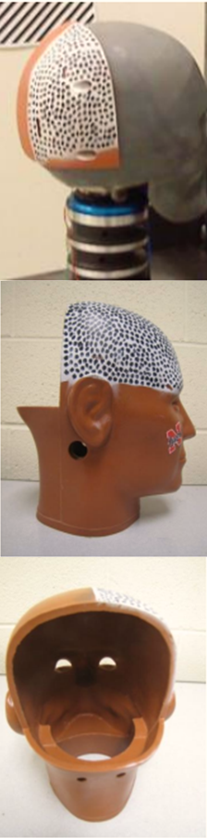
Literature Review: Headform
Scalp
  Skin: two-piece polydimethysiloxane (PDMS)
Skull
  Bone: polyurethane (one piece cast)
Brain
  Neural and glial cells: water
White and Grey Matter
  Silicone gel
    To give viscoelastic properties
Cerebrospinal Fluid
  Water
  Is 99% water in reality
  Gives wanted dampening property
Image and information : Hossain 2010

Slide 6
PROBLEM
Current research does not correlate the external effects of a blast on the skull to internal effects on the brain.
We would like to link local pressure measured by helmet-mounted pressure sensors to strain, pressure, and acceleration in the brain.
Notes:
Allowing for a direct correlation between external local static pressure readings and internal injury.

Slide 7
RESEARCH QUESTION
What is the relationship between the pressure measurements over the surface of the skull and the pressure, strain rate and acceleration of brain tissue in a blast wave injury?
What is the relationship between direction of the blast and the pressure measurements over the surface of the skull?

Slide 8
HYPOTHESIS
  Different dynamic pressure distributions measured over the surface of the skull can be correlated with specific strain rates, pressures, and accelerations in brain tissue during a blast event.
Notes:
As of right now, static pressure has not been explored in terms of strain of the brain. It is relatively unexplored.

Slide 9
METHODOLOGY
Physical Experiment
Computer Model
Create blast wave with a pressure chamber
Create a headform that reflects physical properties of a human head
Record dynamic pressures at the surface of the head
Simulate point blast loading on a human head with a finite element model
Output pressures, strain rates, and accelerations in brain tissue
Data Analysis
Correlate external dynamic pressure with internal variables
Notes:
Hardware – Responsible for the sensor array development and physical linkage to computer interface.
Software – Responsible for signal analysis and data collection from the sensor array.
Of course, this is not a linear process. There will be feedback between the subgroups and refinements will be made.
Analysis – correlation to model

Slide 10
Phase I: Preliminary Research
Physical Experiment
Computer Model
Preliminary data acquisition with microphones
Determine the signal resolution required to measure blast
Establish maximum external pressure produced by pressure chamber
Learn how to use ANSYS modeling software
Analyze effects of model properties on simulation
  Skin
  Skull Density

Slide 11
Phase I: Blast Localization & Model Verification
Physical Experiment
Computer Model
Construction of headform
Build data acquisition circuits
Integrate sensors and helmet for experiments
Localize blast using sensor readings
  With helmet
  With helmet and headform
Run ANSYS simulations corresponding to the physical experiments
Correlate the exterior pressures from the physical and computer models
Rectify the discrepancies between data

Slide 12
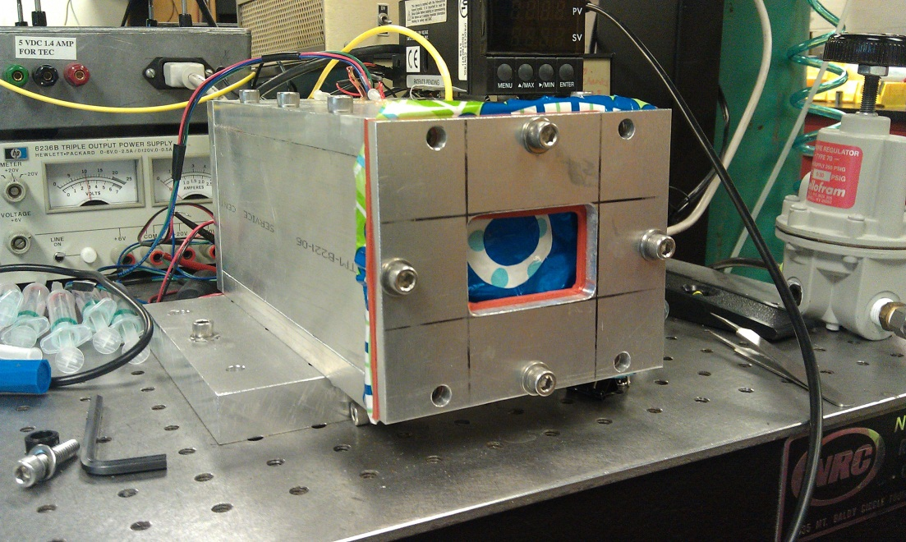
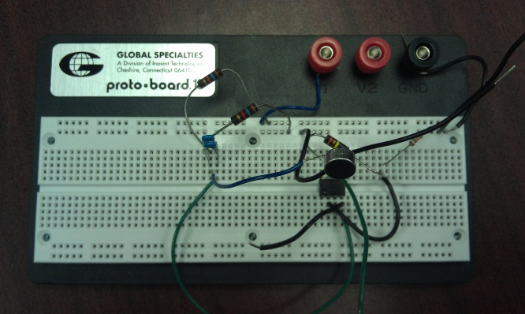
Phase II: Data Collection
Physical Experiment
Computer Model
Distances: 1.0m and 1.5m
Orientations: 90°180°270°
Run simulations corresponding to each physical experiment
Convert output to the proper format for correlation

Slide 13
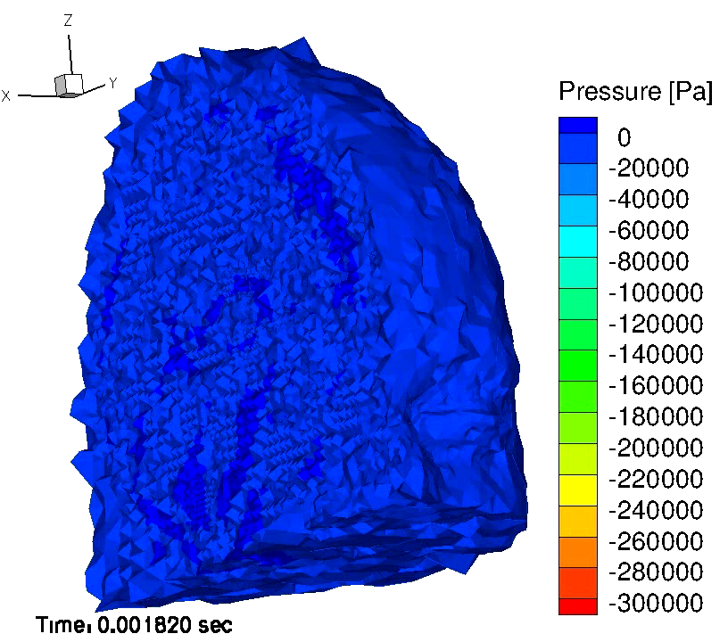
Phase iii: Data Analysis
Correlate physical and computer models
  Pressure from physical model
  Pressures, strain rates and accelerations from computer model
Determine which external locations best predict the internal factors
Moore et. al 2009

Slide 14
Physical Experiment
Headform
Data Acquisition
Scalp
  Insignificant effects on pressure distribution
Skull
  Rapid prototyped polyurethane
  Density: 1.17-1.18 g/cm³
Brain & CSF
  Siligard ® 527 A&B Silicone gel
Support
  Tripod mounted head and helmet
Sensors
  Condenser Microphones
  Piezoelectric
Data acquisition
  NI 9223 DAQ
Signal conditioning
  4-Channel
  1 MS/s sample rate
Data recording
  LABVIEW software

Slide 15
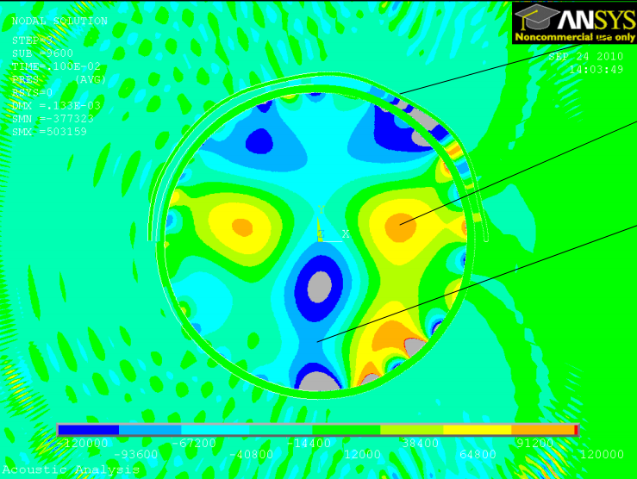
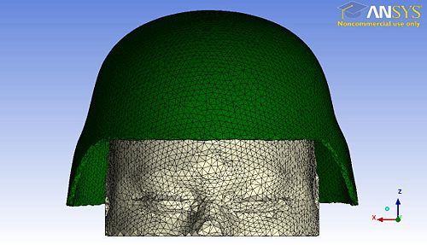
AnSYS Modeling
Finite Element Model
2D mesh and structural properties provided by Dr. Balachandran (UMD)
3D mesh provided by David Moore (MIT)
Load the model with a point blast
Output pressure, strain rate, and acceleration in brain tissue
B. Balachandran and M. F. Valdez 2010
Moore et. al 2009

Slide 16

Data ANALYSIS
Space-time Correlation
2 functions, f (t1) and g(t2), are correlated over a range of time differences
Δt with the highest value of R indicates the closest relationship, establishes time delay
$$R_{f,g}=\frac{\overline{\left(f\left(t,\vec{x}\right)g\left(t+Δt,\vec{x}+Δ\vec{x}\right)\right)}}{\sqrt{{\overline{f}}^{2}}\sqrt{{\overline{g}}^{2}}}$$

Slide 17


Data ANALYSIS
Preliminary Analysis
Primary Analysis
Verify model: correlate pressure readings from simulation to the physical experiment
$R_{f, g}= \frac{\overline{\overline{f\left(t\right)g\left(t\right)}}}{\sqrt{{\overline{f}}^{2}}\sqrt{{\overline{g}}^{2}}}$
Localize blast origin: correlate sensor readings to each other $R_{f, g}= \frac{\overline{\overline{f\left(t\right)g\left(t+∆t\right)}}}{\sqrt{{\overline{f}}^{2}}\sqrt{{\overline{g}}^{2}}}$
Establish correlation between external and internal variables
  External: pressure from readings of sensors
  Internal: acceleration, strain rate, and pressure from simulation $R_{f, g}= \frac{\overline{\overline{f\left(t, \right)g\left(t+∆t\right)}}}{\sqrt{{\overline{f}}^{2}}\sqrt{{\overline{g}}^{2}}}$

Slide 18
IMPLICATIONS
Better Modeling
More Accurate Injury Predictions
Earlier Injury Detection
Better Treatment
Better understanding of blast related injuries
  More effective treatment of TBI victims
Further research
  Helmet design
  Helmet monitoring systems
  More extensive models
Notes:
Researchers can further analyze the static pressure readings and correlation to internal brain injury to develop a model that predicts brain injury from external static pressures

Slide 19
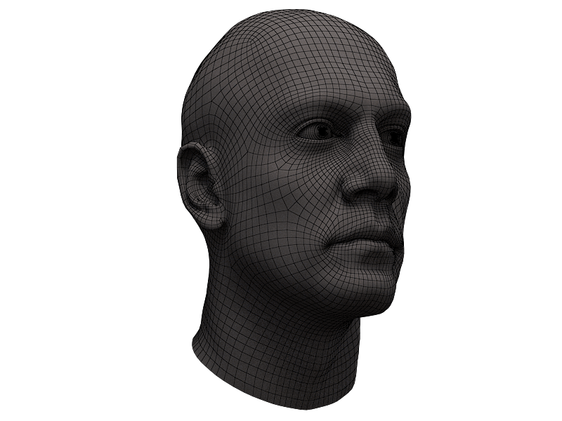
Timeline
Spring 2012
Fall 2012
Spring 2013
Fall 2013
Spring 2014
Begin Preliminary Research
Collect Necessary Materials
Prepare for Experimentation
Phase 1 - Blast Localization and Model Verification
Phase 2 - Data Collection
Begin Phase 3 - Data Analysis
Finish experimentation
Draft Literature Review and Thesis
Write Final Literature Review and Thesis Draft
Finish Thesis
Present at Thesis Conference
Notes:
We need to expand on this… but only with RELEVANT information!
Also, Eddie’s Critique:
-Simplify when too wordy… explain with note cards
-Make timeline more informative… every1 does those (above) things…
-Fix the hypothesis/question? The hypothesis doesn’t really answer the question…

Slide 20

A special thanks to:
  Dr. Miao Yu, our awesome mentor
  Dr. Balakumar Balachandran, our expert
  Nedelina Tchangalova, our librarian
  Dr. Wallace
  Dr. Thomas
  Heather Creek
  Gemstone Staff
Any questions or comments?

